Slide 1


Charlie Group
TatiYana dean, vince sarlo, chad Hendren
Csd 310, Assignment 11.2: Group presentation
December 9th, 2021

Slide 2
Group Introduction
Tatiyana Dean lives in Lexington, KY where she works as a Data Management Specialist at a marketing mail company. She is tirelessly pursuing a B.S. degree in software development to better financially support her singing career. Her passion is singing, songwriting, and all things music. She loves video games as well and, to quote her, “I've always wanted to work with Rockstar Games.”
Vince Salvo is originally from NJ and currently resides in Orlando, FL, where he is a professional musician for the Walt Disney Company. He has performed / recorded percussion for Disney In the US, Japan, and Paris. He graduated from Rutgers University in 2013 with a double major in Psychology and Communications. Vince’s brother’s wife and brother are Software Engineers. After completing Coding Camps years ago, and after seeing how successful they have been in the software field, he decided to study at Bellevue to obtain a B.S. in Software Development in the hopes of establishing a career working from home. Thankfully, Disney is supporting his dream! Vince’s passion in life is to travel and see more of the world after Disney unlocked the what the World offers. Lastly, “I also love video games and would love to work for Riot Games!”

Slide 3
Group Introduction: continues
Chad Hendren resides an hour West of Nashville, TN in a small city named McEwen. He and his wife, Amy, moved to TN from Omaha, NE three years ago and maintain 15 acres of peacefulness. Chad and Amy have six daughters and seven grandchildren with two more grandchildren coming soon. A life-long learner, Chad is close to completing a dual major in Business Information Systems and Software Development. Past that, his goal is to pursue a M.A. or M.S. program at Bellevue University.

Slide 4
Case Study Overview
Jake and Ned Willson have always been interested in finance and investment
They both decided to get a degree in finance, and Ned decided to continue his education by getting an MBA
During the last four years, they noticed that their relatively small town in New Mexico only had one business dedicated to financial management and advising
Understanding that there are many ranchers and farmers that do a good business, and seeing more and more people retiring to the area, they started on a business plan to open up Willson Financial
The first step was for both of them to acquire a CFA license
They then had to decide how to register the company, with the state or with the SEC
Deciding to go with registering with the SEC, they knew they would need help making sure the business remained compliant with SEC regulations

Slide 5
Case Study Overview
When they started running Willson Financial, they hired one office employee, Phoenix Two Star, who would take care of client appointments, office supplies, and other office duties
They also hired a part-time compliance manager, June Santos, to ensure that the company would stringently follow all regulations required by the SEC, with whom the company is registered
While Jake and Ned know that the customer list has grown in the past year, they’ve been so busy that they decided it was time to step back, take a look at the client list, their assets, and the billing process to make sure the customers were getting the best service possible, while keeping the business in the black
One decision to make is whether to change the billing structure

Slide 6
Case Study Overview
Some of the questions to be answered are:
How many clients have been added for each of the past six months?
What is the average amount of assets (in currency) for the entire client list?
How many clients have a high number (more than 10 a month) of transactions?

Slide 7
The ORD
Logical definitions and relationships

Slide 8
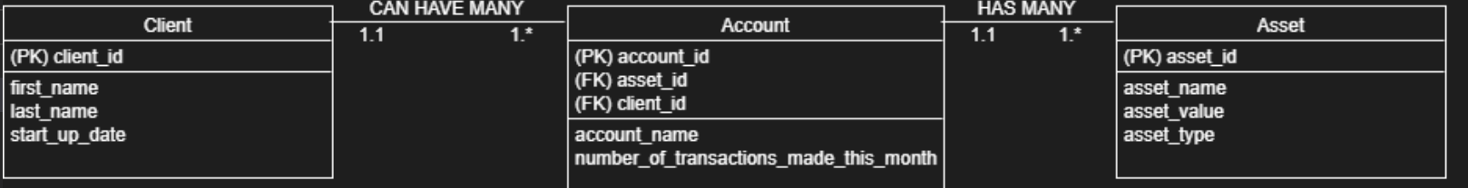
ORD
Our Approach and Assumptions:
We rationalized the database requirements to include three tables as depicted above
Our datasets include assumed values that highlight instrumentation of the business rules within the ORD
This data population drives the upcoming report examples and proves the business rules’ success

Slide 9
The Reports
Three standard reports to meet use case needs

Slide 10
Three Reports
The generated reports address each of the following:
How many clients have been added for each of the past six months?
What is the average amount of assets (in currency) for the entire client list?
How many clients have a high number (more than 10 a month) of transactions?

Slide 11
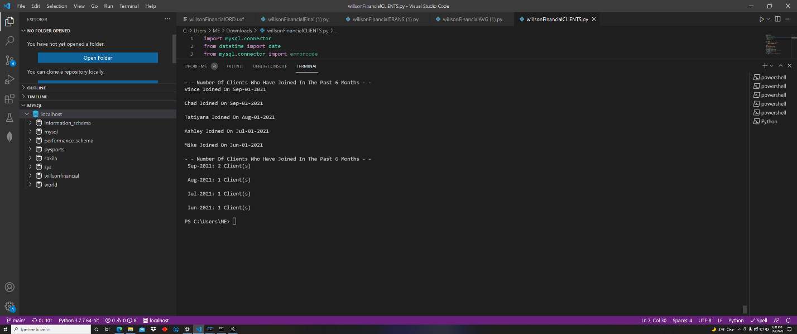
How many clients have been added for each of the past six months?

Slide 12
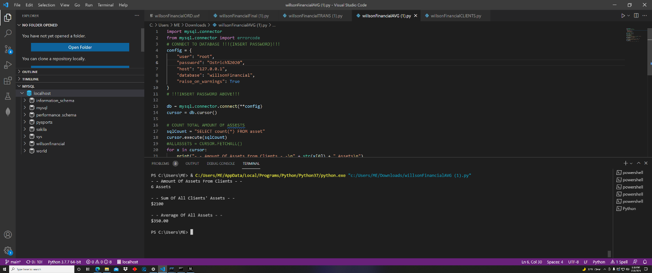
What is the average amount of assets (in currency) for the entire client list?

Slide 13
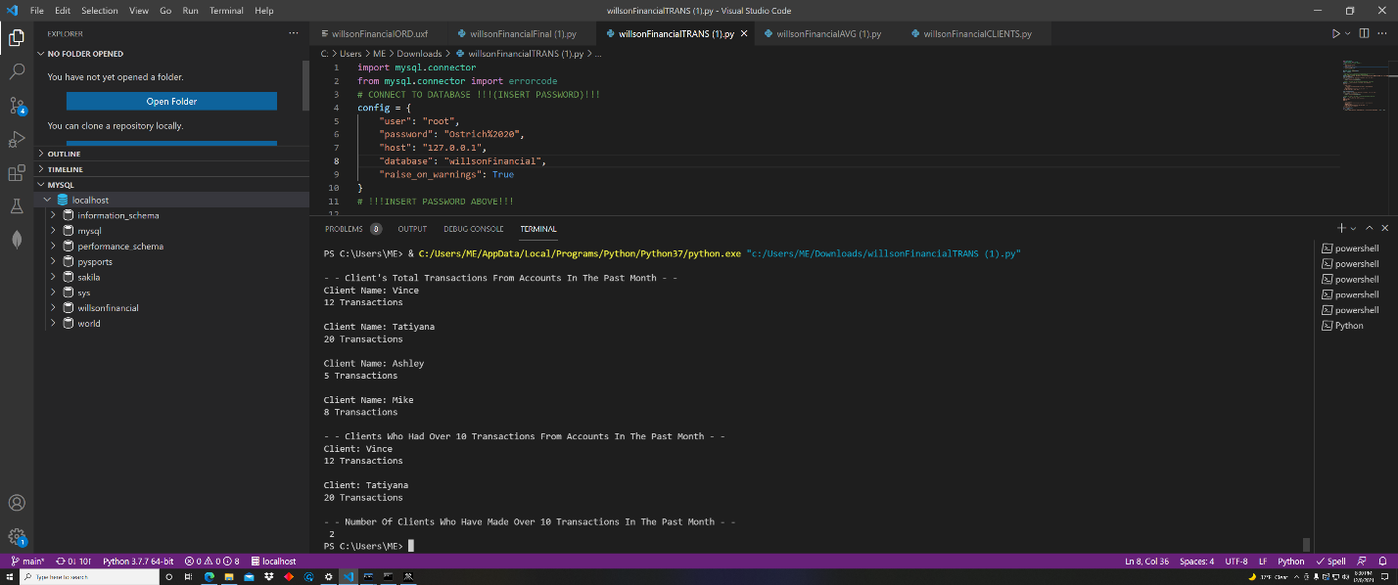
How many clients have a high number (more than 10 a month) of transactions?

Slide 14
Charlie Group
TatiYana dean, vince sarlo, chad Hendren
Csd 310, Assignment 11.2: Group presentation
December 9th, 2021

